Slide 1
Project Details: COVID – 19 Vaccinations Analysis

Slide 2
Aim – This Project mainly aims to find out the trend of the vaccinations around the world for the prevention of the Covid 19 pandemic and how much has been achieved so far.

Slide 3
Introduction – The COVID 19 pandemic caused due to the Corona virus devastated the world by causing several fatalities around the world. This virus originated in Wuhan, China in 2019 and was later spread throughout the world due to human contact in one way or the other. The disease showed symptoms as basic as mild fever and cold but also caused life threatening symptoms like breathing problems caused by damage to the lungs.

Slide 4
•In later stages of 2020 several experimental vaccines were developed and was administered to humans. The efforts were successful as the vaccines were helpful in reducing the affects the virus and even if people were infected, they were not in any life threating situation and escaped the illness having only minor symptoms.

Slide 5
•Many countries later developed their own vaccines and also helped other countries without the resources by providing them with vaccines developed.

Slide 6
Problem Statements – •In this project we have analyzed the top 10 fully vaccinated countries •We have analyzed the top 5 vaccinated countries •We have analyzed the top 5 daily vaccinating countries •We have analyzed the total number of daily vaccinations, people who have fully vaccinated, people who is vaccinated •We have analyzed year wise daily vaccinating details, fully vaccinated people details, vaccinated people details.

Slide 7
Methodology – Step 1 – Data Importing – In power BI desktop with the help of the get data option import the CSV data which is named as country_vaccinations and clicked load option.

Slide 8
Step 2 – Data Cleaning – After loading the data and after analyzing the data | understood that there are 86512 rows and 15 columns. And in that some of the columns contained null values I have replaced the null values by 0 with the use of replace functions and started working on the data.

Slide 9
Step 3 – Visualizations – In visualization part with the help of power BI desktop software I have used different kinds of charts, graphs, cards and table to display the data in the format which will be easy to understand.

Slide 10
Analysis – In the analysis part first | have analyzed the top 10 fully vaccinated countries by using area chart and have used the filter option to find the top countries and the result obtained as below, From the below image we can able to come to know that India is the top country in terms full vaccination with 116 billon , followed by united states of America and china with 67 billion and 35 billion respectively.

Slide 11
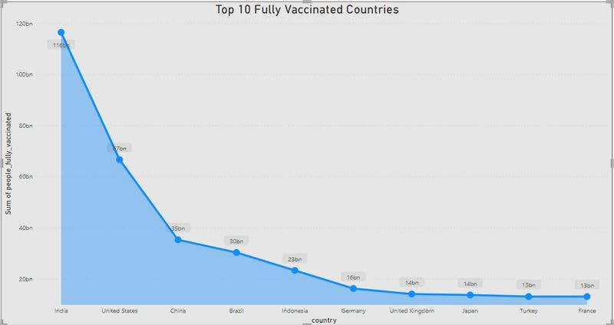

Slide 12
•In the second analysis we have analyzed the top 5 vaccinated countries with the help of pie chart and used filter option to find the top countries and with that we came to know that India is the top country with more number of vaccinated peoples followed by United States of America and Brazil.

Slide 13
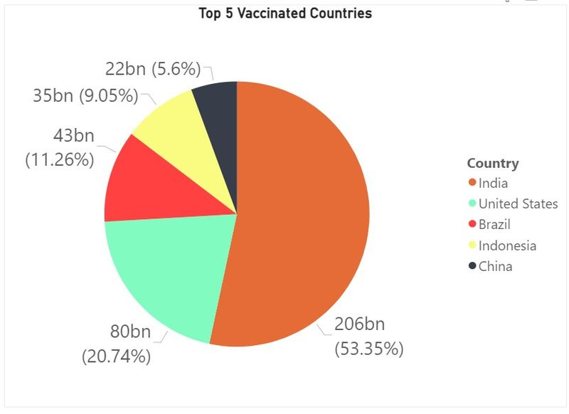

Slide 14
•In the third analysis we have analyzed the top 5 country with daily vaccinations with the help of pie chart and used filter option to find the top country with daily vaccinations and with that we came to know that China is the top country with more number of vaccinations followed by India and United States of America.

Slide 15
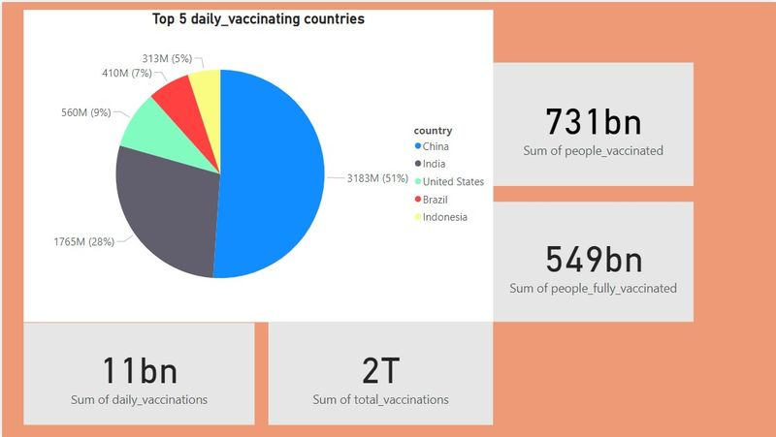

Slide 16
•From the above images we have came to know about the statics of daily vaccination, people who have fully vaccinated and people who is vaccinated and I used cards for this to display the value.

Slide 17
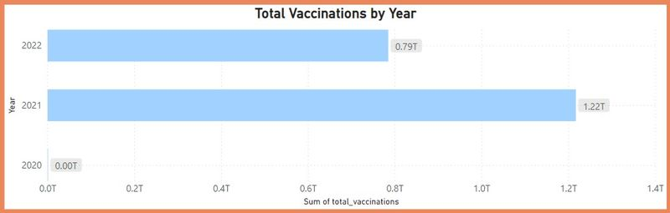

Slide 18
•Above image have shown that daily vaccinating details year wise and here we can conclude that 2021 is a year which having maximum daily vaccinating details and I have used bar chart.

Slide 19
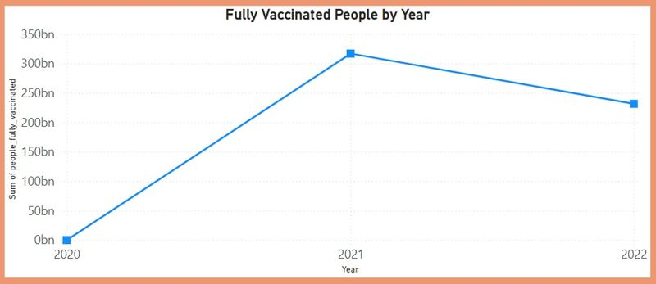

Slide 20
•Above image have shown that fully vaccinating details year wise and here we can conclude that 2021 is a year which is having maximum number fully vaccinated peoples and I have used Line chart.

Slide 21
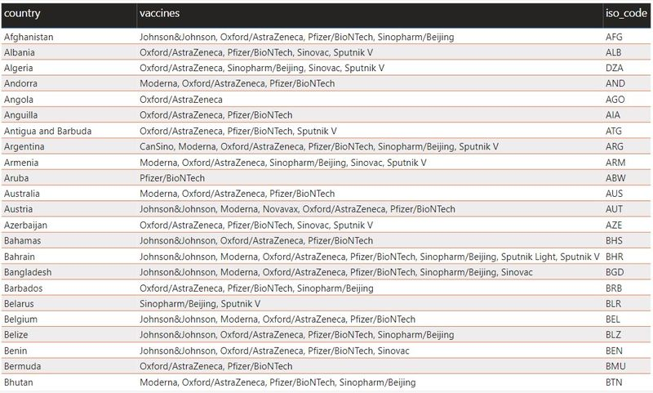

Slide 22
•From the above chart I have used table to understand the vaccine details and iso_code details country wise.

Slide 23
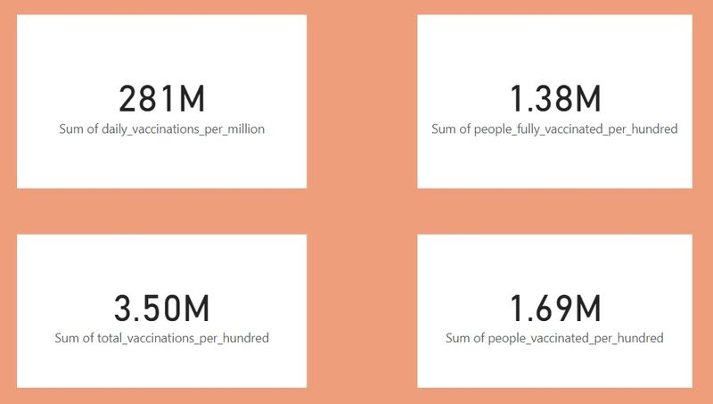

Slide 24
•From the above images we have analyzed the daily vaccinations per million, people who have fully vaccinated per hundred, people who have vaccinated per hundred, total vaccinations per hundred.

Slide 25
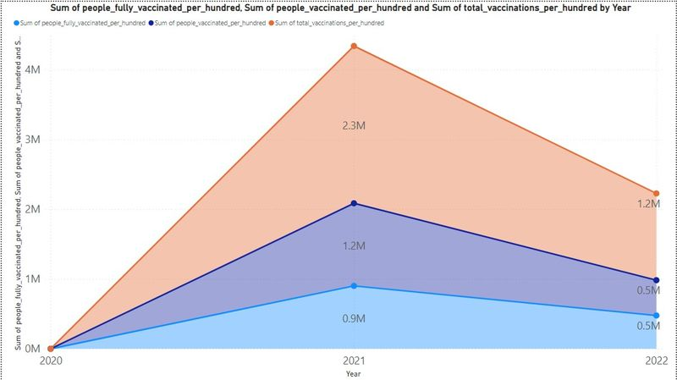

Slide 26
•People who have vaccinated per hundred, people who have fully vaccinated per hundred, total vaccinated per hundred and we came. To know about that 2021 was the peak year in all the 3 cases.

Slide 27
Insights – Here we analyzed the top 10 fully vaccinated countries in which India tops the list which indicates that people in the country where showing lots of interests to get vaccinated. And also analyzed top 5 vaccinated countries here also India tops the list. And then analyzed top 5 daily vaccinating countries and here China tops the list.

Slide 28
Recommendations – We should collect day to day reports and we should update our records daily to get more accurate details. So that we can move forward with more vaccination to the right country which needs the most.

Slide 29
Conclusions – In this dataset we came to know that the vaccination process in every country was going in good pace that indicates we can have control of this disease very soon all over the world.

Slide 30
Example program:- # Import necessary libraries import pandas as pd import numpy as np import matplotlib.pyplot as plt import seaborn as sns from scipy.stats import ttest_ind # Step 1: Data Collection # Assuming you have a CSV file named ‘covid_vaccine_data.csv’ data = pd.read_csv(‘covid_vaccine_data.csv’)

Slide 31
# Step 2: Data Preprocessing # Handle missing values data = data.dropna() # Convert categorical features into numerical representations (if needed) # You might use techniques like one-hot encoding or label encoding # Step 3: Exploratory Data Analysis # Explore data characteristics, identify trends, and outliers summary_stats = data.describe() correlation_matrix = data.corr()

Slide 32
# Step 4: Statistical Analysis # Perform statistical tests (e.g., t-test for vaccine efficacy) group1 = data[data[‘Group’] == ‘Group A’][‘Efficacy’] group2 = data[data[‘Group’] == ‘Group B’][‘Efficacy’] t_stat, p_value = ttest_ind(group1, group2) # Step 5: Visualization # Create visualizations to present key findings plt.figure(figsize=(10, 6)) sns.barplot(x=‘Age_Group’, y=‘Adverse_Effects’, data=data) plt.title(‘Adverse Effects Across Age Groups’) plt.show()

Slide 33
Step 6: Insights and Recommendations # Provide actionable insights based on the analysis mean_efficacy_groupA = group1.mean() mean_efficacy_groupB = group2.mean() if mean_efficacy_groupA > mean_efficacy_groupB: recommendation = “Consider prioritizing Group A vaccine for broader distribution.” else: recommendation = “Group B vaccine shows higher efficacy on average.”

Slide 34
Print(f”Mean Efficacy – Group A: {mean_efficacy_groupA:.2f}%”) print(f”Mean Efficacy – Group B: {mean_efficacy_groupB:.2f}%”) print(“Statistical Test p-value:”, p_value) print(“Recommendation:”, recommendation)

